Slide 1
Flights data set
flight delay data
GROUP 30
COMP5048

Slide 2

Nagib Shah Xinan Ma Alan Shen Young Choi Qiushi Zhang Girishkumar Dhotarkar
GROUP MEMBERS:
470360839 470489934 470194809 470346338 470119101 470351620

Slide 3
CONTENT
01
Introduction
Design
02
03
Implementation
Evaluation
04
05
Progress
Planning
06

Slide 4
Introduction: Data set&Aim
01

Slide 5
Introduction:Data set
Select datasets
Select key criterion
Datasets were considered for selection by mentioned criterion.
E.G.
Team skills profile,
Available references for Visualisation
Select
criterion
Select
datasets
Finalize on Flight (delay) data set
Analyse each data set
Finalize on Flight (delay) data set
...
Analyse each data set
....

Slide 6
Introduction:Aim
Visualise best time of year for travelling with minimal flight delays.
Visualise performance of airports and carrier year on year.
Visualise negative effect of specific incident or event on flight delay.
Visualise best performing airport(s) performance for a single year.

Slide 7
02
Design
Analysis&Visualisation

Slide 8
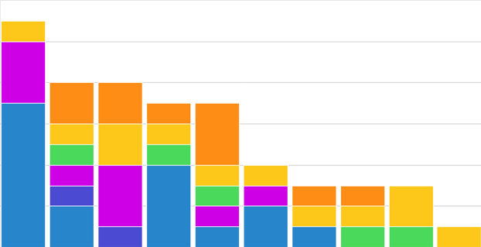
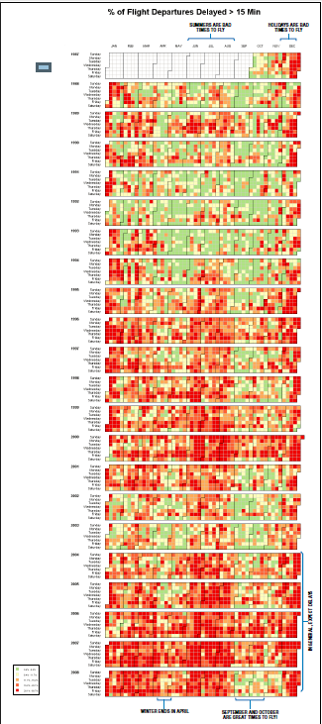
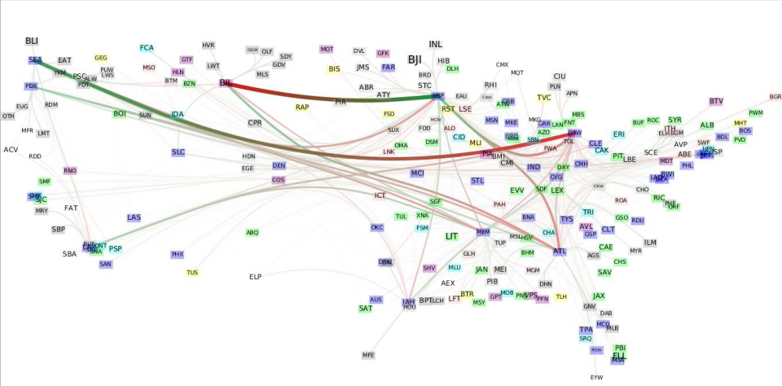
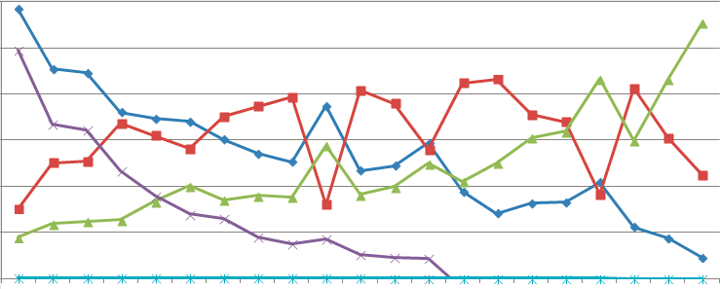
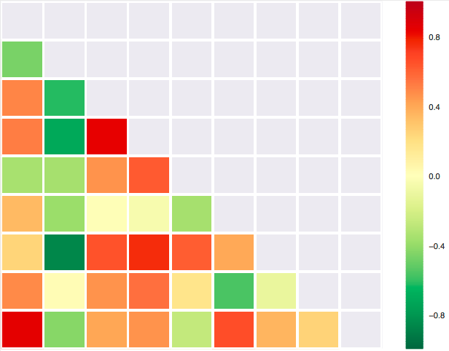
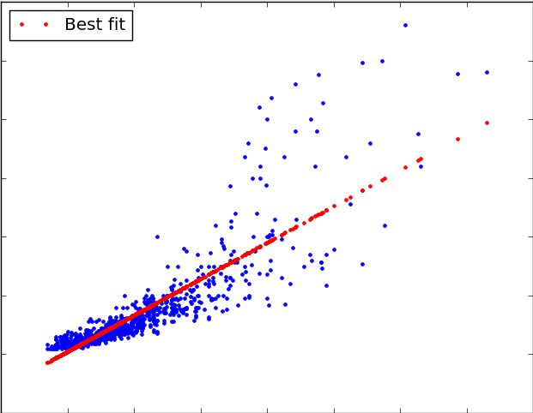

The Data
From 1999 to 2008, ten years of data on commercial domestic flights forairports in the United States .
Goals
【Temporal exploration】
• What is the best time for travelling?
• Time-lapse series of graph showing performance of airports (year to year)
• The airline/airport delay and performance influenced by perticulare global events. e.g:1999 - 2000 & 2001
【Spatial exploration】
• Find the worse/best performing airports and airlines?
Tools
Group Members
PROJECT LEARNED:
•
•
•
•
•
•
•

Slide 9
03
Implementation

Slide 10
Implementation
Develop code or use software tools to visualise
& perform testing
Evaluate and finalise visualisation
Cleanse data
& Create Indexes
Step 2
Step 4
Step 6
Step 1
Step 3
Step 5
Extract & Load of data
Develop & test queries for each visualisation
Peer review

Slide 11
04
Evaluation

Slide 12
05
Progress

Slide 13
06
Planning

Slide 14
Planning
Decide aims
&finalize draft
Implementation
14/09
16/09
21/09
22/09
13/10
Analyse data sets
&finalize data set
Design
Evaluation
E.G.
Peer Review

Slide 15
GROUP 30
THANK YOU

